Slide 1
Using Data Science to Advance Cancer Research
By Kaitlyn Torres and Charles Howard

Slide 2
Table of contents
01
02
03
04
Introduction
Methodology
Introduces Data Science and its uses and importance pertaining to the healthcare field
Describes the methods and processes used to extract and analyze data
Results analysis
Conclusions
Findings for United States, New York, and Florida
Key takeaways from this Project and Future Steps

Slide 3
1
Introduction
The Story Behind Our Research

Slide 4
What is Data Science
Goal:
Find evidence that supports or challenges a hypothesis.
How?
analyse data to find patterns, anomalies, and/or correlations between different types of information
ex: predictive modeling, statistical analysis, clustering, etc…

Slide 6
Technologies
There are many different tools that can be used when using data science:
1. Data Storage: Excel, CSV, JSON, txt files, etc
2. Data extraction/ analysis: Python, R
3. Data Visualization: Tableau, Power BI, Python (plotly, ggplot, etc )

Slide 7
The Rise of Data Science
Once only prevalent in technical fields, data science has emerged in a variety fields that include but are not limited to:
Education
Finance
Marketing
HEALTHCARE

Slide 8
Data Science in Healthcare
Benefits:
Better diagnostics
Early detection of issues
Used to help and diagnose patients virtually
Usage:
Discover new drugs using Artificial Intelligence
Analysis of Medical Imaging (MRIS, CAT)
Disease Tracking and Prevention
Diagnose Cancer at early stages

Slide 9
Data Science Focused on Cancer
Machine Learning and AI in Cancer Prognosis, Prediction, and Treatment Selection: A Critical Approach
https://www.ncbi.nlm.nih.gov/pmc/articles/PMC10312208/
One project that inspired us uses Machine Learning to predict cancer growths, their prognosis, and the treatment recommendation. For a school project with a timeline of four months, we did not have the time, money, or ability to use the broader machine learning and AI techniques. Machine learning has been effective in predicting breast, brain, lung, liver, and prostate cancer.

Slide 10
Data Science Focused on Cancer
Building Capacity for Global Cancer Research: Existing Opportunities and Future Directions
https://www.ncbi.nlm.nih.gov/pmc/articles/PMC8285681/
This paper examines the efforts to address the gaps in global cancer research at the National Institutes of Health. Low income and middle income countries have an increasing burden due to cancer, estimating that by 2040, 75% of 21 million new cancer cases and 13 million cancer deaths will occur in those countries. This is due to aging populations, and epidemiological transition that is occurring in parallel with improved economic prosperity and reduction of infectious disease propagation.

Slide 11
2
Methodology
You can enter a subtitle here if you need it

Slide 12
Do you need longer text?
Mercury is the closest planet to the Sun and the smallest one in the entire Solar System. This planet's name has nothing to do with the liquid metal, since Mercury was named after the Roman messenger god. Despite being closer to the Sun than Venus, its temperatures aren't as terribly hot as that planet's. Its surface is quite similar to that of Earth's Moon, which means there are a lot of craters and plains
Speaking of craters, many of them were named after artists or authors who made significant contributions to their respective fields. Mercury takes a little more than 58 days to complete its rotation, so try to imagine how long days must be there! Since the temperatures are so extreme, albeit not as extreme as on Venus, and the solar radiation is so high, Mercury has been deemed to be non-habitable for humans

Slide 13
Results Analysis
3
You can enter a subtitle here if you need it

Slide 14
United States Results

Slide 15

United States Analysis
We have grabbed all 50 states and got the count of cancer incidences by cancer type per state

Slide 16
For this Project, we chose to analyze New York and Florida
United States Population Heatmap
Cancer per State Heatmap

Slide 17
New York Results

Slide 18
New York Analysis
We have grabbed all 62 counties and got the count of cancer incidences by cancer type per county
We figured since it's the city that never sleeps, there are higher rates of illness stemming from sleep deprivation.

Slide 19
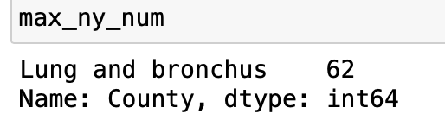
Top Cancer is the Same Amongst All Counties
Lung and Bronchus Cancer is unanimously the most prevalent cancer across all counties

Slide 20
Here is a list of the most prevalent cancer sites in each county
Suffolk has 4 sites that they are the top county in
These are Bladder, Melanoma, Leukemia, and Lung/Bronchus

Slide 21
Florida Results

Slide 22
Florida Analysis
We have grabbed all 67 counties and got the count of cancer incidences by cancer type per county

Slide 23
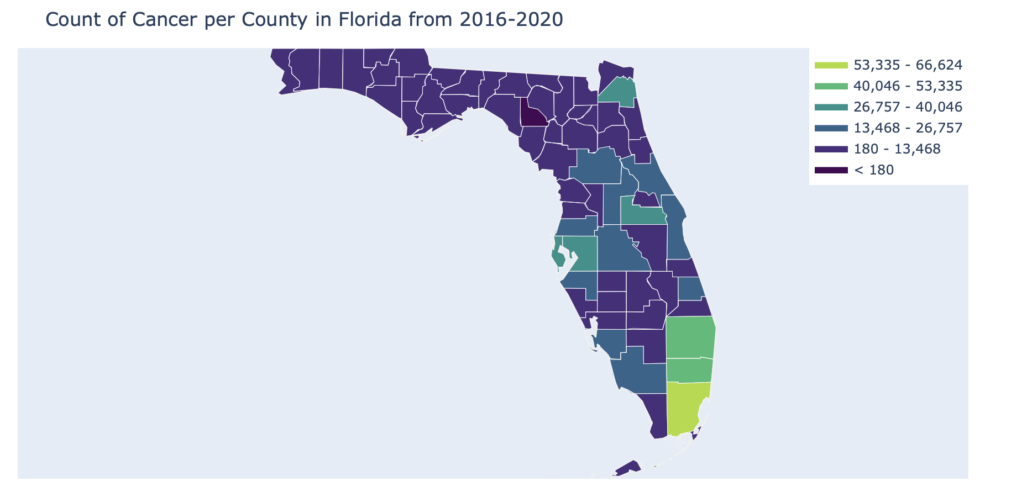
Cancer Rates are Higher in Southern Florida
Florida Counties Heatmap

Slide 24
Most Prevalent Cancer by County
The most prevalent Cancer in 50/67 Counties in Florida is Bronchus
The most prevalent Cancer in 15/67 Counties in Florida is Breast
The most prevalent Cancer in 1/67 Counties in Florida is Melanoma (Glades)
The most prevalent Cancer in 1/67 Counties in Florida is Prostate (Union)

Slide 25
Melanoma
The county where Melanoma is most prevalent is Glades
Glades is the third smallest out of 67 counties both in population and in incidences of cancer
Glades is in southern Florida which explains why the Melanoma rate is so high compared to the rest

Slide 26
Prostate
The county where Prostate Cancer is most prevalent is Union.
Union County is in the bottom third of counties with cancer prevalence.
The ratio of male to female is 62% to 38%, which could explain the higher prevalence of Prostate cancer. This is the highest ratio across all the counties.

Slide 27
Bronchus
Bronchus is most prevalent cancer across 50 counties.
The main cause is smoking, and Florida has a 14.5% smoking rate.
The smoking population heavily skews toward the older population, and Florida has a large population that aims to retire there.
Specifically, Putnam County has a smoking rate of 25%, compared to Florida's overall smoking rate of ~15%.

Slide 28
Breast
15 Counties out of 67 have Breast as most prevalent.
14/15 Counties have a higher female : male ratio
Sumter is the one county out of the 15 with a higher male : female ratio
Why is Breast Higher than Bronchus or Prostate in Sumter County?

Slide 29
Sumter County
15 Counties out of 67 had Breast as most prevalent.
14/15 Counties have a higher female : men ratio
Sumter is the one County out of the 15 with a higher male : female ratio
Oldest county in United States
Has been (on numerous accounts) ranked best in state for smoking
Lowest recorded smoking rate of 12%

Slide 30
4
Conclusion
You can enter a subtitle here if you need it

Slide 31
5
Citations

